Slide 1
Madison County Health Department (MCHD) Laboratory Services
Laboratory services are performed on site by licensed and accredited Laboratory Professionals.

Slide 2
MCHD Laboratory Professionals
Elizabeth Wilson RMA CPT
Laboratory Technician

Slide 3
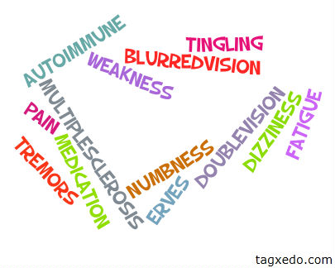
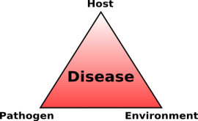
Laboratory Testing
Laboratory tests aid in determining the presence, extent, or absence of disease and monitor the effectiveness of treatment. 70 percent of patient's diagnosis and treatment, are based on laboratory test results.

Slide 4
Lab Test Are Vital to Your Health
Medical laboratory testing plays a crucial role in the detection, diagnosis and treatment of disease in patients. Doctors rely on laboratory testing results to make informed patient diagnoses.
Laboratory professionals contribute to wellness testing, guiding treatment, and monitoring patient progress.

Slide 5
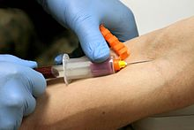
Laboratory Testing
Pregnancy Testing
Prenatal care
Sickle Cell
RSV Testing for 18&under
Strep Test
Hemoglobin
Blood Glucose
Glucose Tolerance Test (GTT)
Urine Drug Screening Test
Urinalysis
Wet Prep/Amine for Vaginal Infections (Yeast, and Trichomonas)
Fecal Occult Blood
Gonorrhea Cultures and Gram Stains

Slide 6
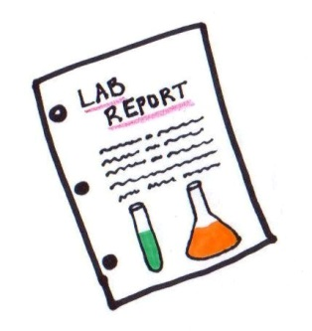
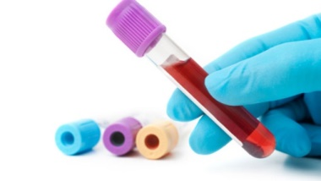
Laboratory Test
Gonorrhea/Chlamydia Testing
HIV
Syphilis
Hepatitis B
Hepatitis C
Rubella
Pertussis
PAP Screening
Colposcopy
ABO and Rh Testing (Maternity Only)
Antibody Screening (Maternity Only)
Varicella Titer

Slide 7
Maternal Health testing
Laboratory services for our Maternal Health patients:
Hemoglobin
Urinalysis
Wet Prep w/ Amine
Urine Culture
Varicella titer
Hemoglobin A1C
Glucose Tolerance Test (GTT)
ABO/RH Blood typing
Antibody screening
Rubella
HIV, Syphilis, Hepatitis, Chlamydia, Gonorrhea

Slide 8
Adult Health
Know your health numbers!
Blood Pressure
Glucose
A1C
Cholesterol
Body Mass Index (BMI)
Schedule an Adult Health physical today!

Slide 9
Family Planning
Birth Control
Pap Smear Screening
Chlamydia/Gonorrhea
Urinalysis
Hemoglobin
Wet Prep/Amine

Slide 10
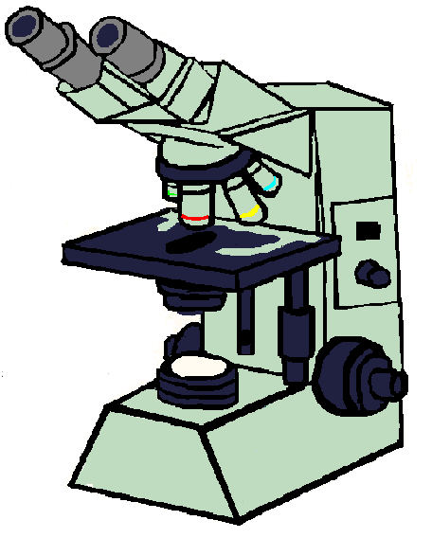
STD Laboratory
Sexual Transmitted Disease (STD)
HIV
Syphilis
Gonorrhea
Chlamydia
Wet Prep/Amine

Slide 11
BCCCP Laboratory
Breast Cancer and Cervical Cancer Program (BCCCP)
Pap Smear Screening
Mammogram

Slide 12
Wise Woman Program
Lipid Panel
A1C

Slide 13
Child Health
Well Child
Children 1 to 6 years of age
Hemoglobin
Blood Lead Analysis

Slide 14
Make the Most of Today—and Make it Beautiful
Madison County Health Department strives to provide the best possible care in a warm and comfortable environment
We educate and encourage you to take care of your self and your health

Slide 15
LAB FEES
LABORATORY FEES ARE TO BE PAID AT TIME OF SERVICE

Slide 16
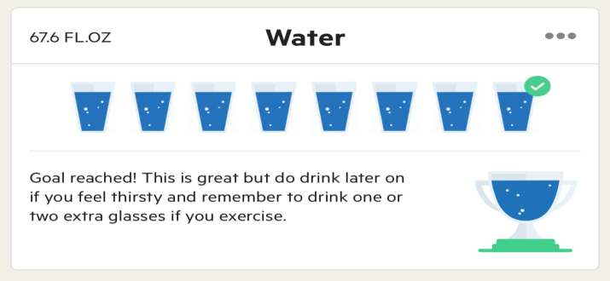
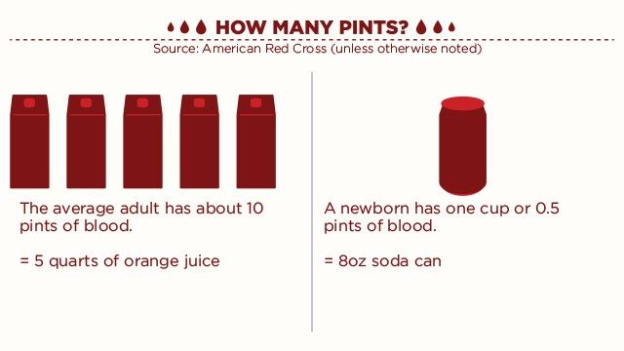
LAB FACTS
DID YOU KNOW?
The volume of blood in a human body is approximately 7 percent of body weight.
An average adult body with a weight of 150 to 180 pounds will contain approximately 4.7 to 5.5 liters (1.2 to 1.5 gallons) of blood.
DID YOU KNOW?
Health authorities recommend eight (8-ounce) glasses of water each day; the 8x8 rule. Equals 2 liters or half a gallon

Slide 17
blood pressure chart by the American Heart Association.
Blood Pressure Category | Systolic mm Hg (upper #) |  | Diastolic mm Hg (lower #)
Normal | less than 120 | and | less than 80
Prehypertension | 120 – 139 | or | 80 – 89
High Blood Pressure (Hypertension) Stage 1 | 140 – 159 | or | 90 – 99
High Blood Pressure (Hypertension) Stage 2 | 160 or higher | or | 100 or higher
Hypertensive Crisis (Emergency care needed) | Higher than 180 | or | Higher than 110
Systolic
The top number, which is also the higher of the two numbers, measures the pressure in the arteries when the heart beats (when the heart muscle contracts).
Diastolic
The bottom number, which is also the lower of the two numbers, measures the pressure in the arteries between heartbeats (when the heart muscle is resting between beats and refilling with blood).
Blood pressure is typically recorded as two numbers, written as a ratio ex: 120/80

